Slide 1
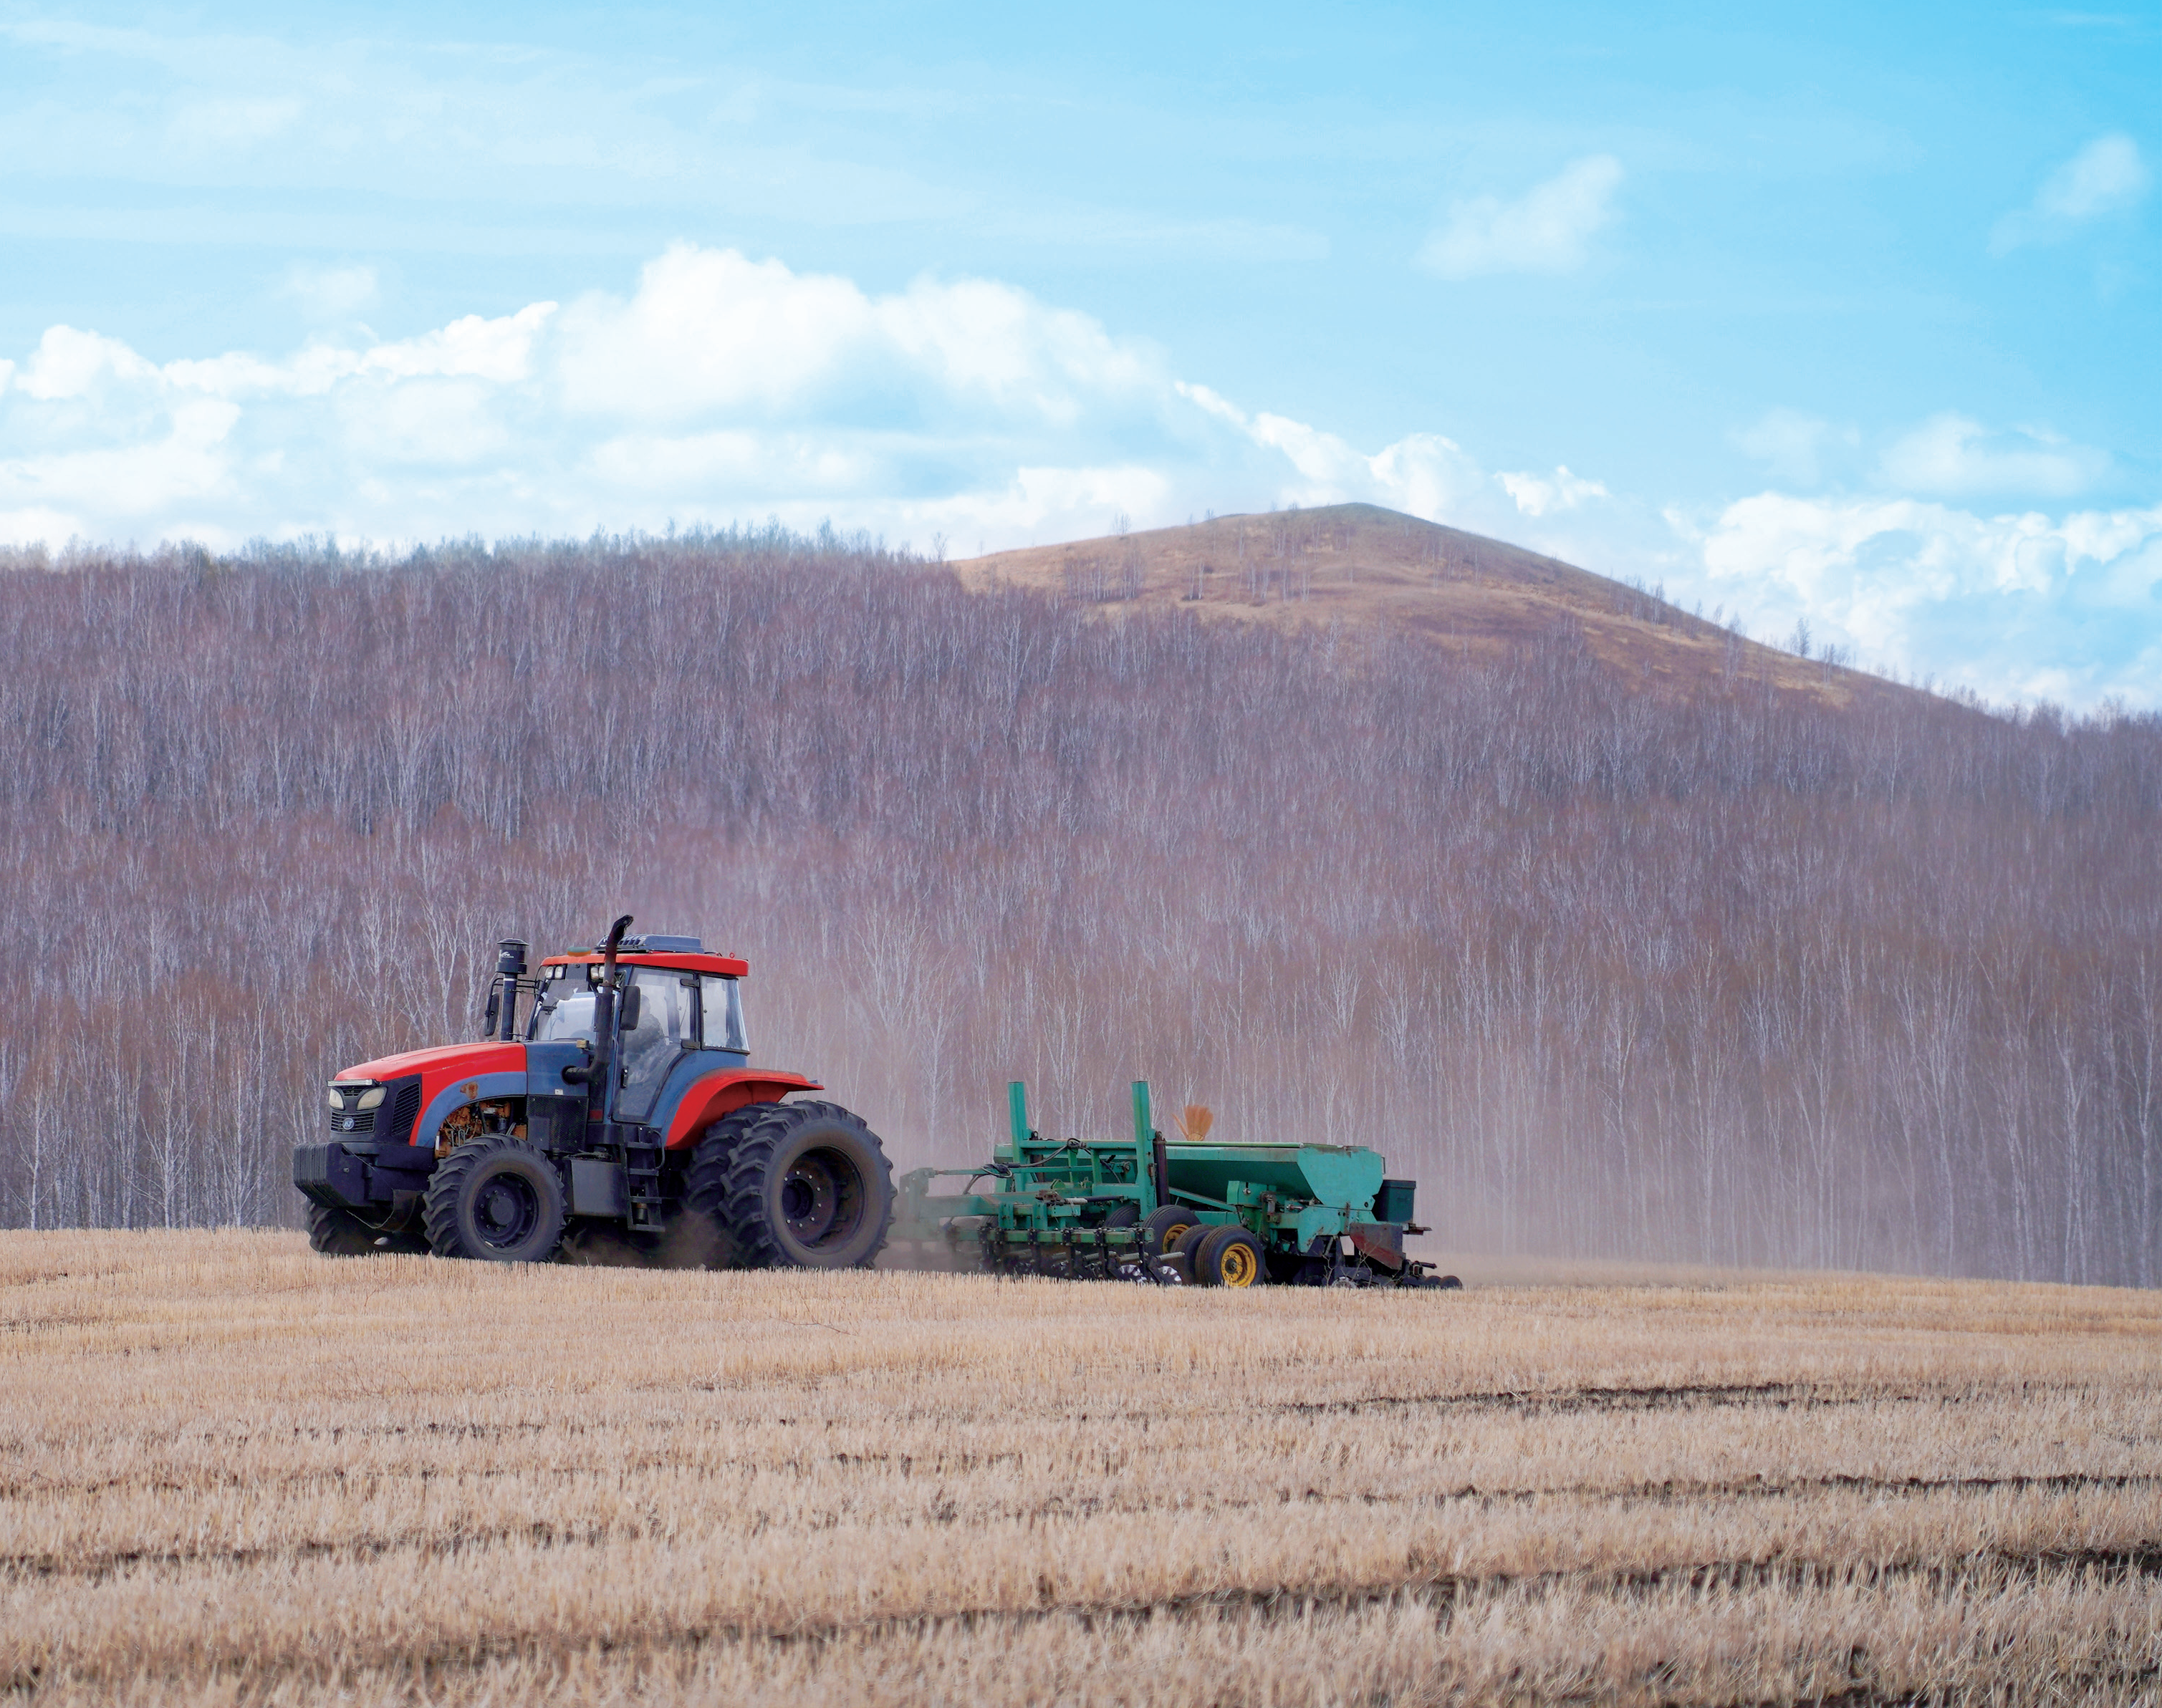
Precision Agriculture Solutions- ESNav5.0
EFIX AG TEAM

Slide 2
CONTENTS
MAIN INTERFACE
QUICK GUIDE
NEW FEATURES

Slide 3
1.MAIN INTERFACE

Slide 4
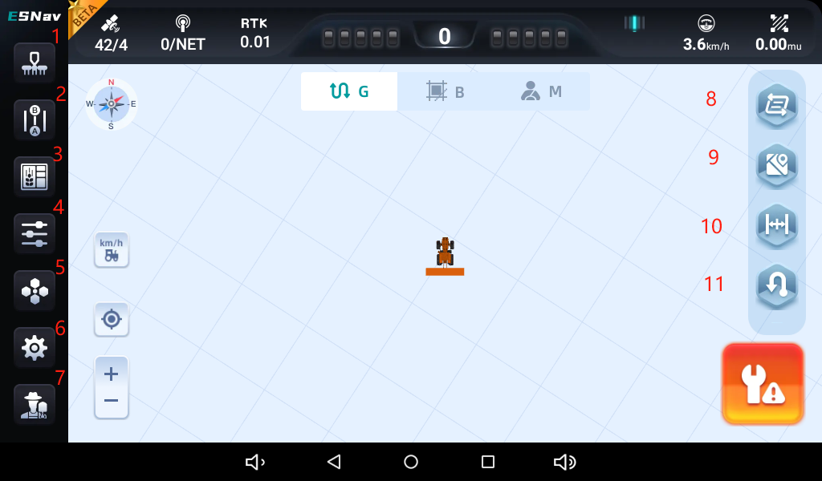
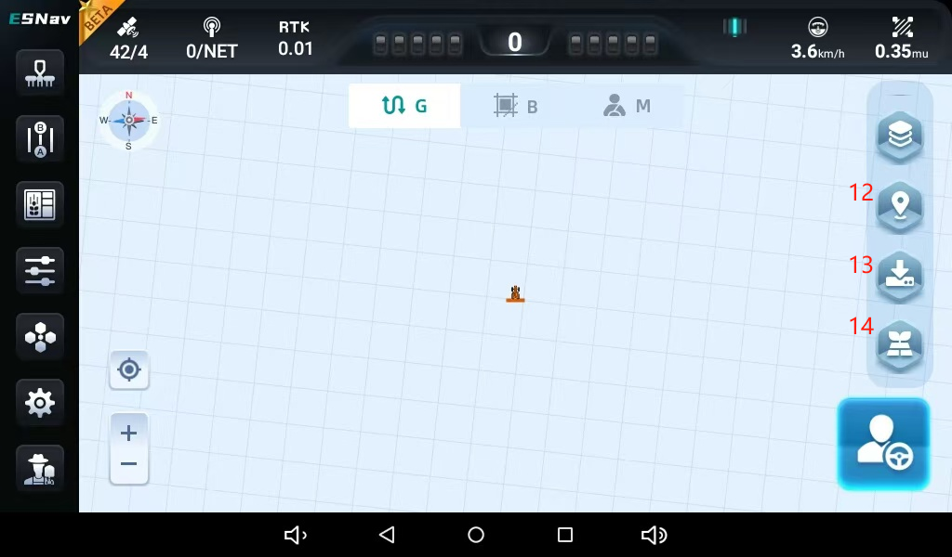
MAIN INTERFACE
SOFTWARE BROWSING
1
Implement settings
8
Guidelines switch
2
New guideline
9
Painting
3
Field management
10
Line offset/RZ
4
Parameter settings
11
Advanced U-Turn
5
UI settings
12
Painting Color
6
Settings center
13
Markers
7
About
14
Trajectory Recording

Slide 5
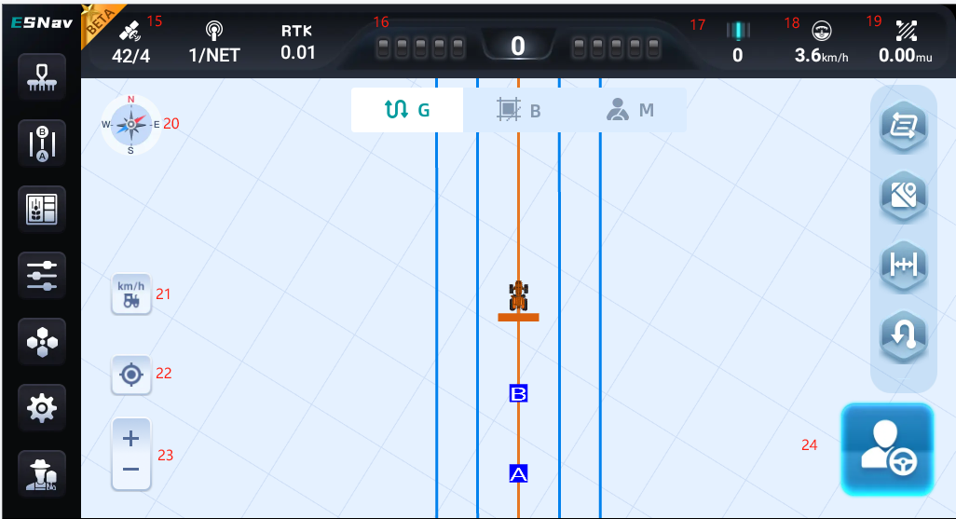
MAIN INTERFACE
SOFTWARE BROWSING
15
GNSS status
20
Compass
16
Lateral deviation
21
Demo speed slider
17
Guideline number
22
Vehicle locking
18
Real-time speed
23
Zoom in/out
19
Worked Area
24
Auto/manual button

Slide 6
2. QUICK GUIDE

Slide 7
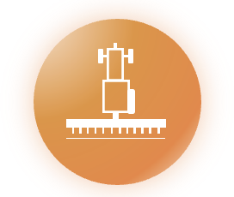
QUICK GUIDE
GNSS MODE
GNSS MODE

Slide 8
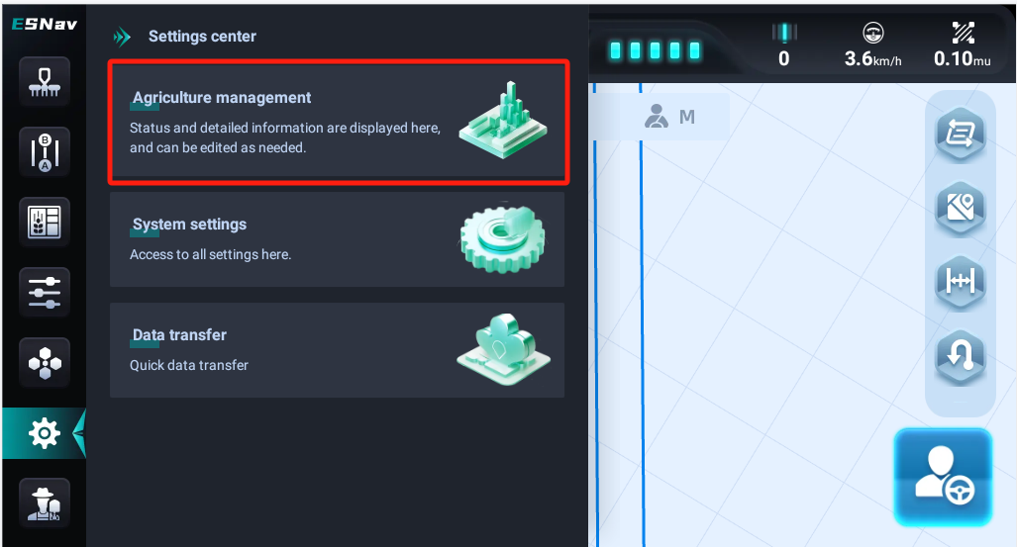
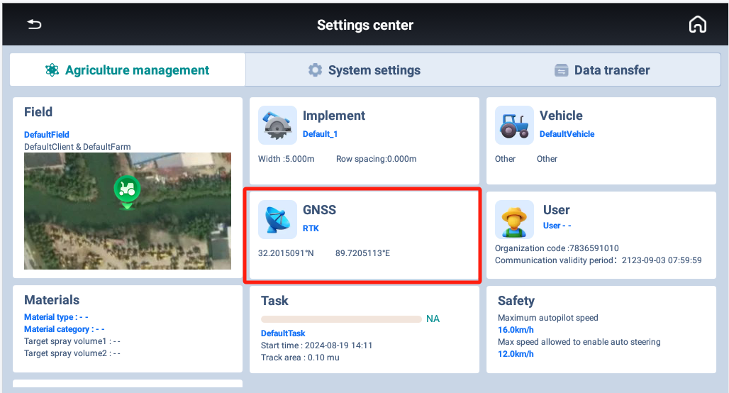
QUICK GUIDE
GNSS MODE
Go to [Agriculture management]---[GNSS]
1. Multiple constellations with GPS/GLONSS/BDS/GALILEO/QZSS enable/disable;
2. Clear ephemeris to reset the GNSS board;
3. Mulitple work modes with SPP, DGPS, RTK, EPPP, HPPP and DRSMOOTH.

Slide 9
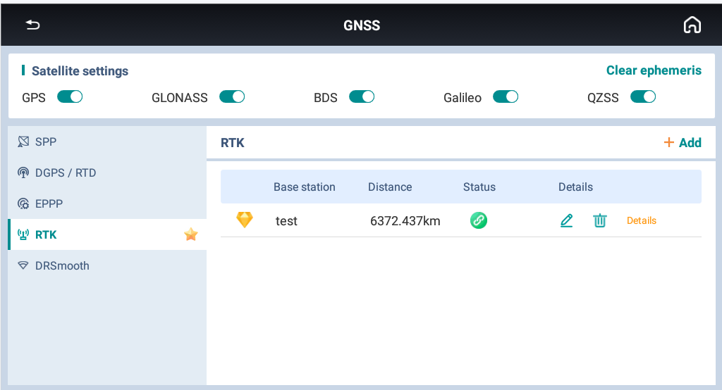
QUICK GUIDE
GNSS MODE
Go to [Agriculture management]---[GNSS]
1. Multiple constellations with GPS/GLONSS/BDS/GALILEO/QZSS enable/disable;
2. Clear ephemeris to reset the GNSS board;
3. Mulitple work modes with SPP, DGPS, RTK, EPPP, HPPP and DRSMOOTH.

Slide 10
QUICK GUIDE
VEHICLE
VEHICLE

Slide 11
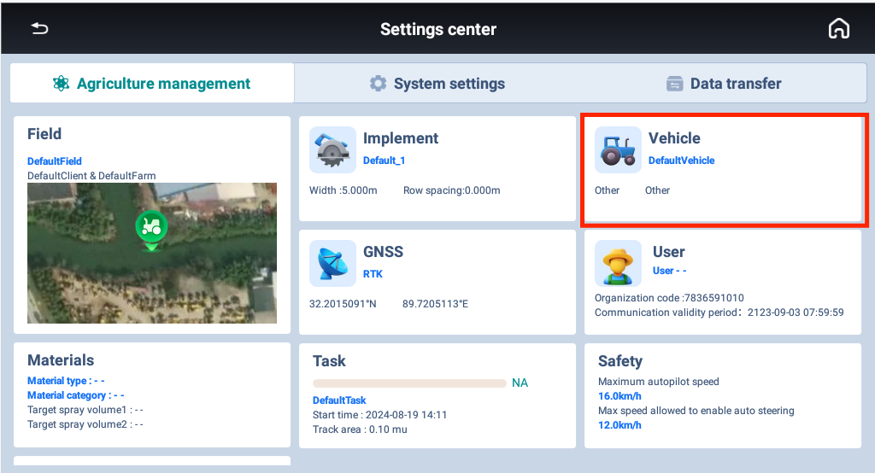
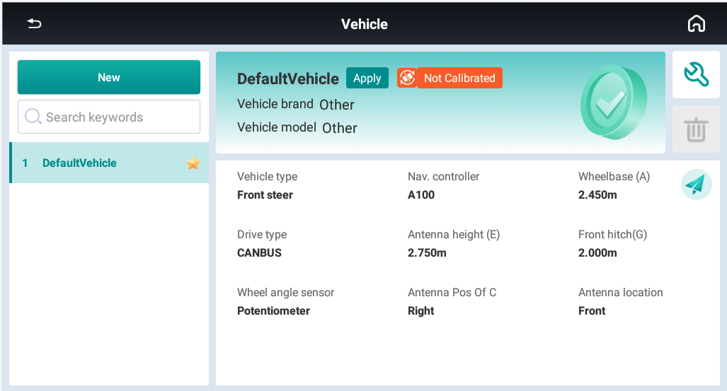
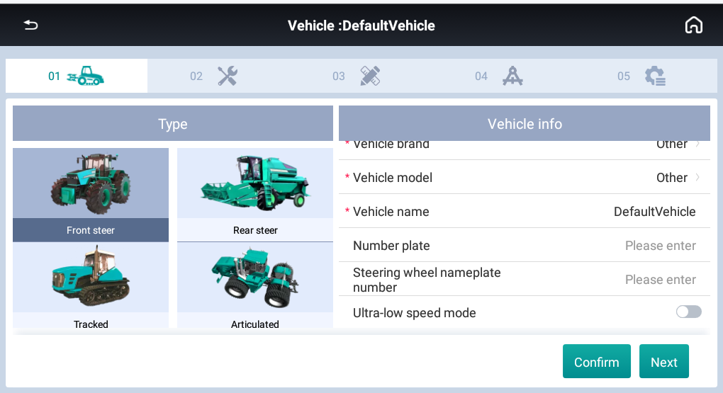
QUICK GUIDE
VEHICLE
VEHICLE SELECTION
Go to [Vehicle]---[New] to create a new vehicle
1. Select one vehicle type with Front Steer, Rear Steer, Tracked, Aticulated, Transplanter;
2. Set vehicle brand, model and name;
3. Ultra-low speed mode with supporting minimum 0.1KM/H speed.

Slide 12
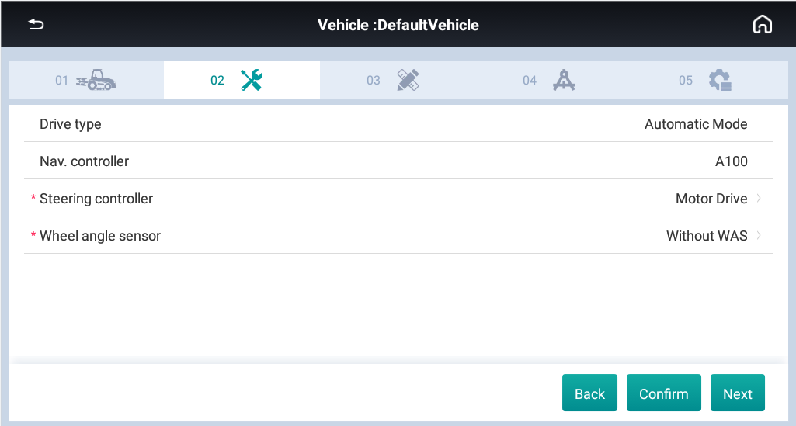
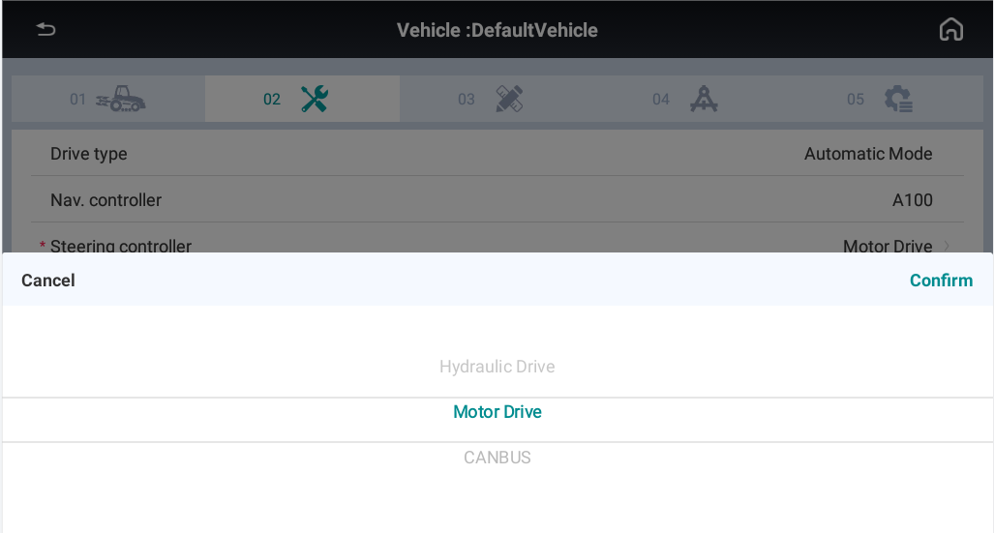
QUICK GUIDE
VEHICLE
VEHICLE CONTROL
1. Select the steering control method:
Motor/Hydraulic(PWM)/CANBUS;
2. Select the wheel angle sensor mode:
Potentiometer/GASensor/Without WAS.

Slide 13
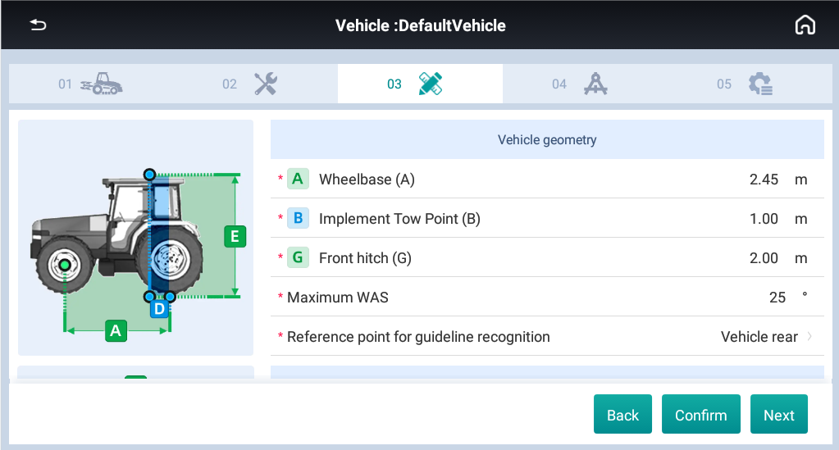
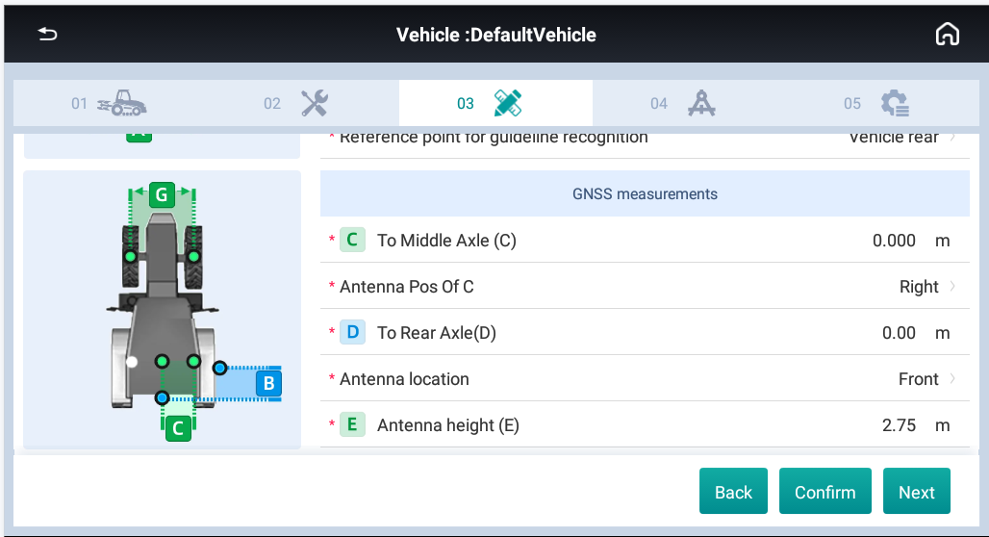
QUICK GUIDE
VEHICLE
VEHICLE PARAMETERS
A: Distance between front and rear axle.
B: Distance from rear axle to mount point.
G: The distance between the front wheels center lines.
Maximum WAS: The maximum angle vehicle can turn.
Locking line reference point: Vehicle rear or head

Slide 14
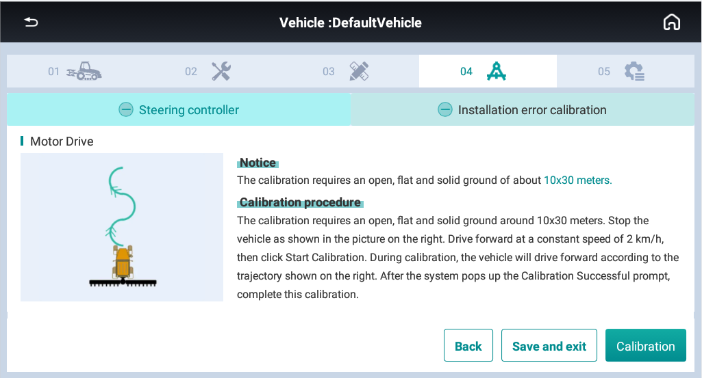
QUICK GUIDE
VEHICLE
VEHICLE STEERING CALIBRATION
1. The calibration requires an open, flat and hard ground about 10*30 meters.
2. Keep the tractor run at 2km/h and click [Start]. During the process, the steering wheel will turn automatically.
3. When the screen shows “Waiting for calibrating…”, around 2 minutes later, the calibration will be successful.

Slide 15
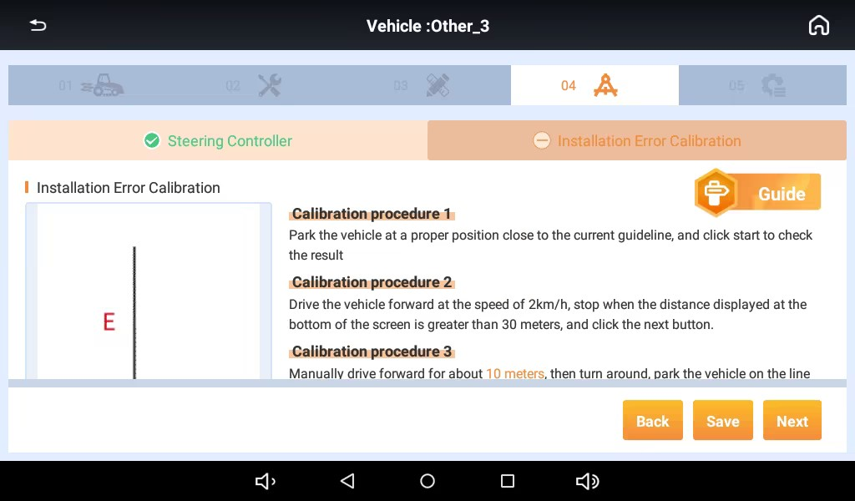
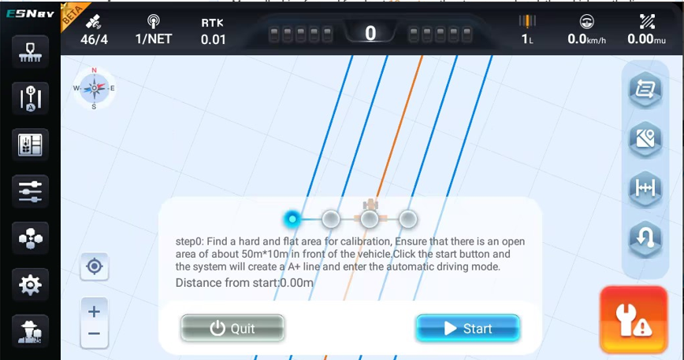
QUICK GUIDE
VEHICLE
VEHICLE INSTALLATION CALIBRATION
1. The calibration requires an open, flat and hard ground about 10*30 meters.
2. Click [Start] and it will set a guideline automatically. The vehicle will get into the auto mode.
3. When the distance from start is over 30m, stop the vehicle, click [Next]. Then it will record the END point and switch to manually mode.

Slide 16
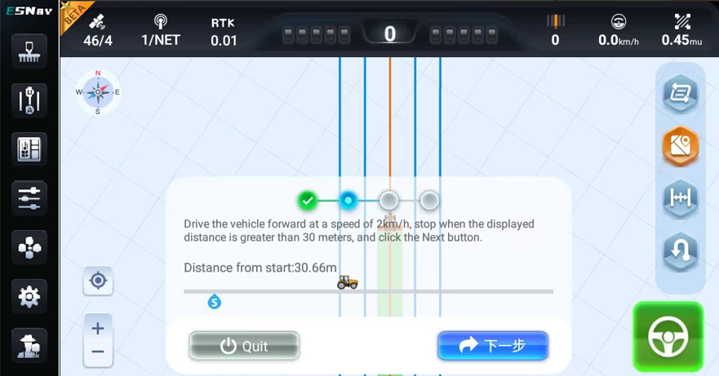
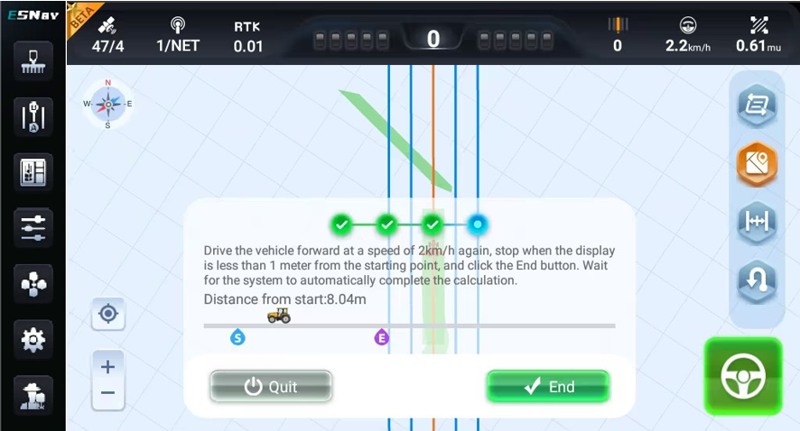
QUICK GUIDE
VEHICLE
VEHICLE INSTALLATION CALIBRATION
4.Turn around and back to the same guideline. After enter the line, click [Next] and the it will switch to Auto mode.
5.Then drive forward automatically and keep the speed between 2-3km/h.
6.Stop the vehicle when the distance from start point is below 1m. Click [End], the system will complete automatically.

Slide 17
QUICK GUIDE
IMPLEMENTS
IMPLEMENTS

Slide 18
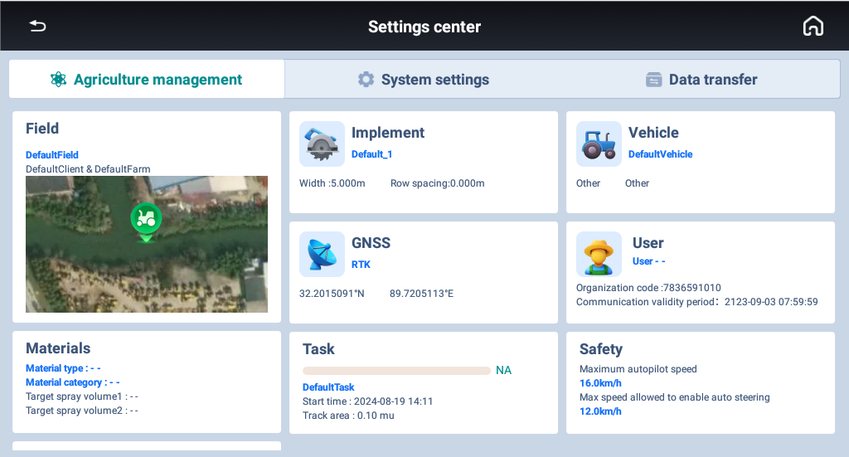
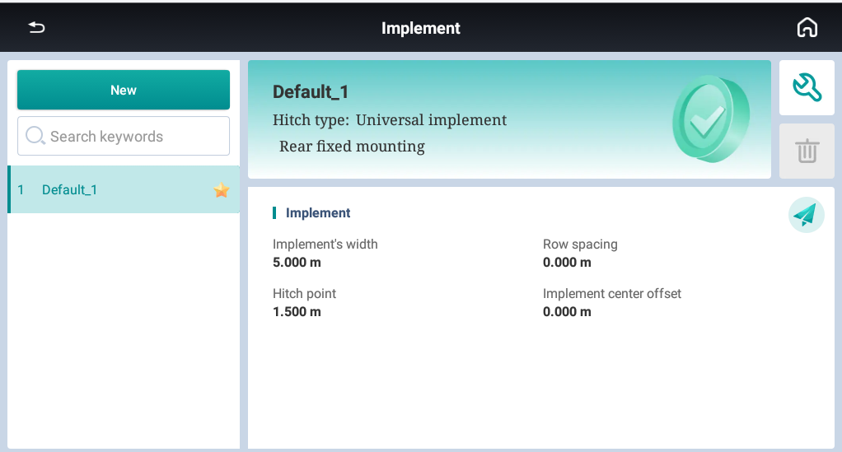
QUICK GUIDE
IMPLEMENTS
IMPLEMENTS
Go to [Implement]---[New] to create a new implement
Info:
a. Manage/new implements or view implements details on this interface.
b. Supports to export implements information.

Slide 19
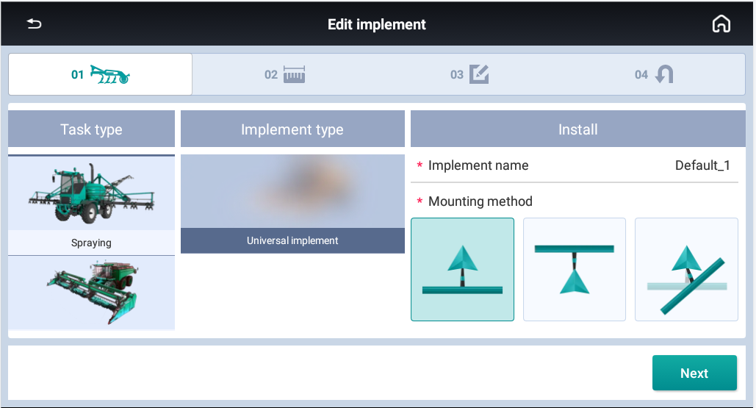
QUICK GUIDE
IMPLEMENTS
IMPLEMENT SELECTION
Job type:
Spraying/Ridge building/Planting/Spreading Harvest/Scatter sowing/Water and fertilizer/Tilling
Mounting method: Rear/Front/Single point mounted

Slide 20
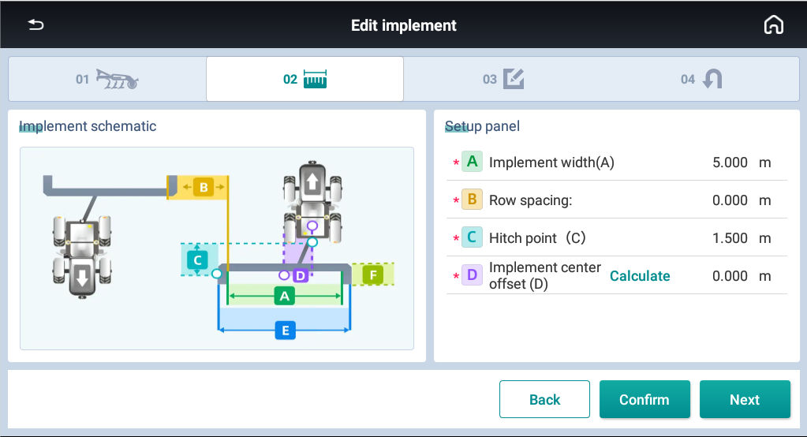
QUICK GUIDE
IMPLEMENTS
IMPLEMENT PARAMETERS
A: Implement width
B: Row spacing (The distance between two passes)
C: Hitch point (The distance from hitch point to implement, just keep the default value 0 )
D: Implement center offset

Slide 21
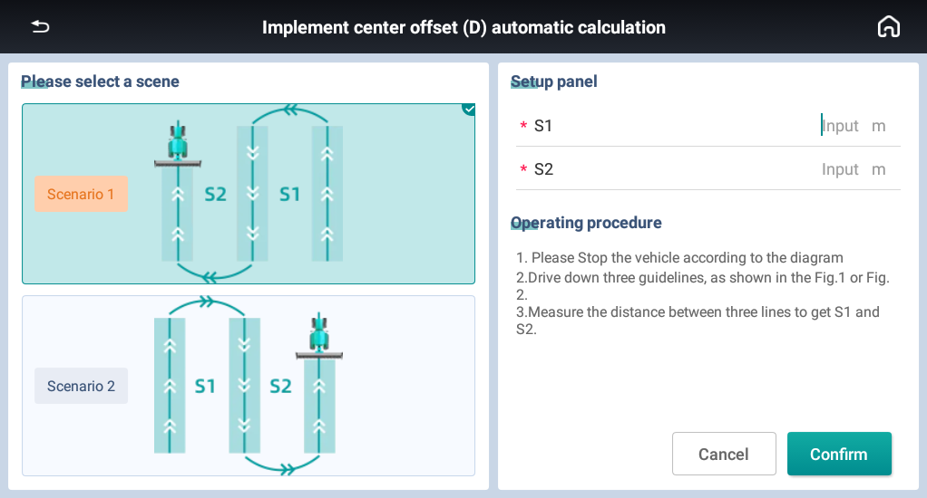
QUICK GUIDE
IMPLEMENTS
IMPLEMENT ROW SPACING AUTO ADJUSTMENT
Auto calculation
If there is the row spacing issue with skip or overlap, it is necessary to click [Calculate] to make offset calculation.
There are two methods to choose, then follow the instruction.

Slide 22
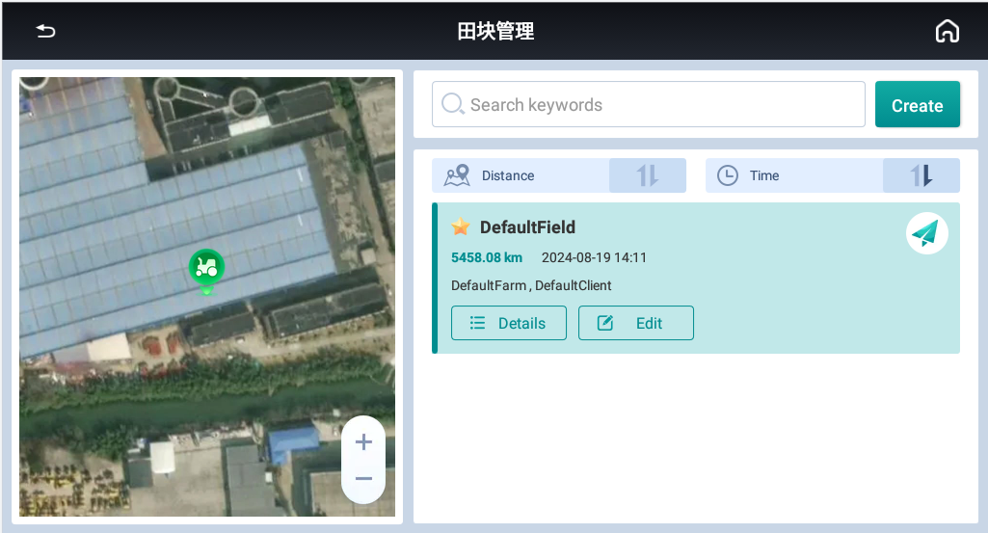
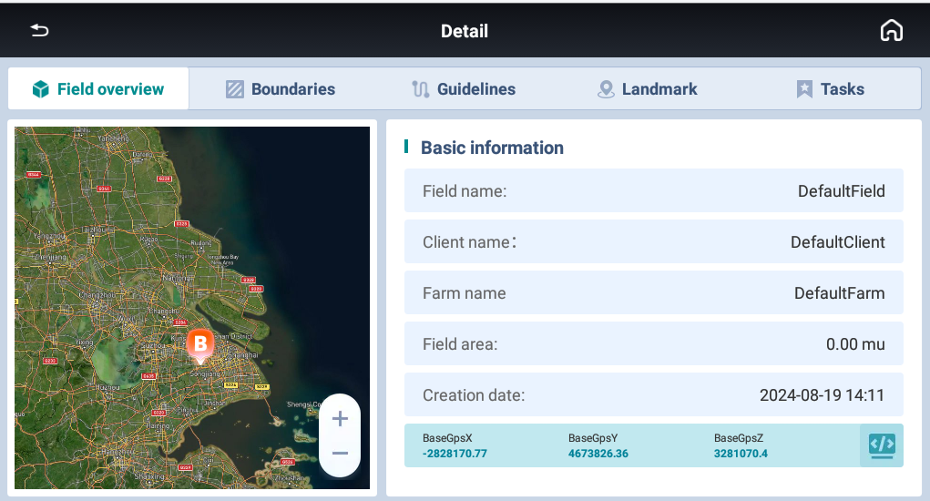
QUICK GUIDE
FIELDS
Go to [Field]---[New] to create a new field
Info:
a. Manage/new fields or view fields details on this interface.
b. Supports to export fields

Slide 23
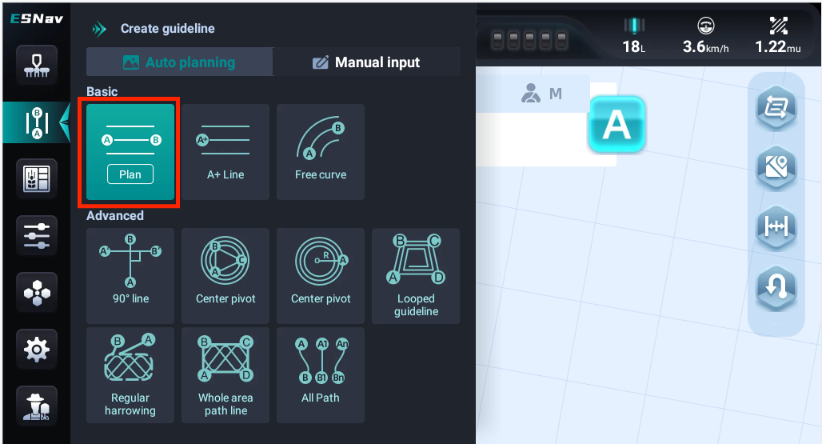
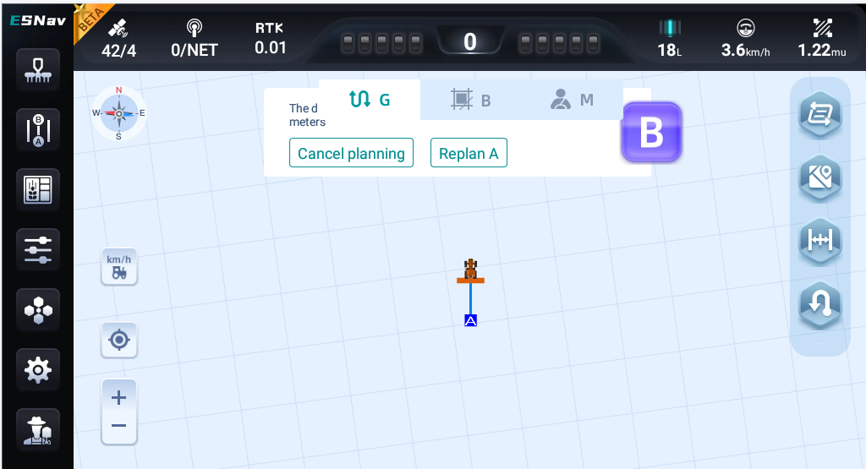
QUICK GUIDE
GUIDELINES
Go to [Field]---[New] to create a new field

Slide 24
3. NEW FEATURES

Slide 25
NEW FEATURES
CLOUD SERVICES
CLOUD SERVICES

Slide 26
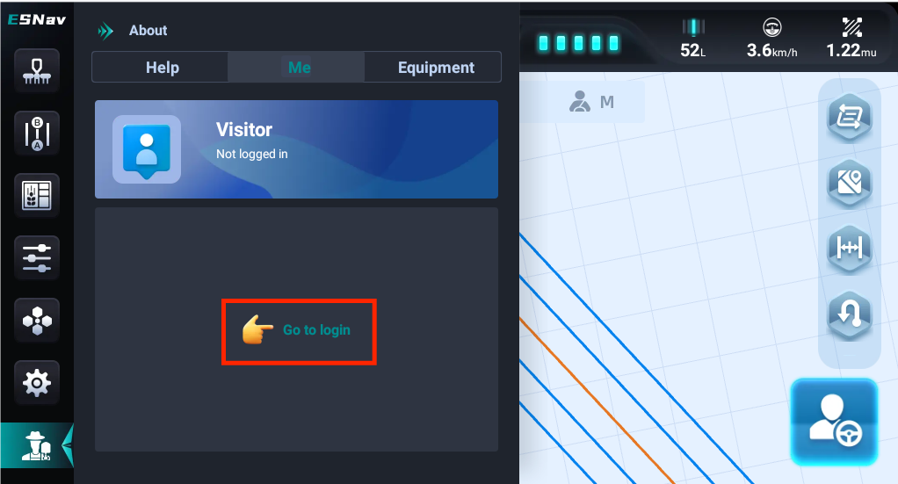
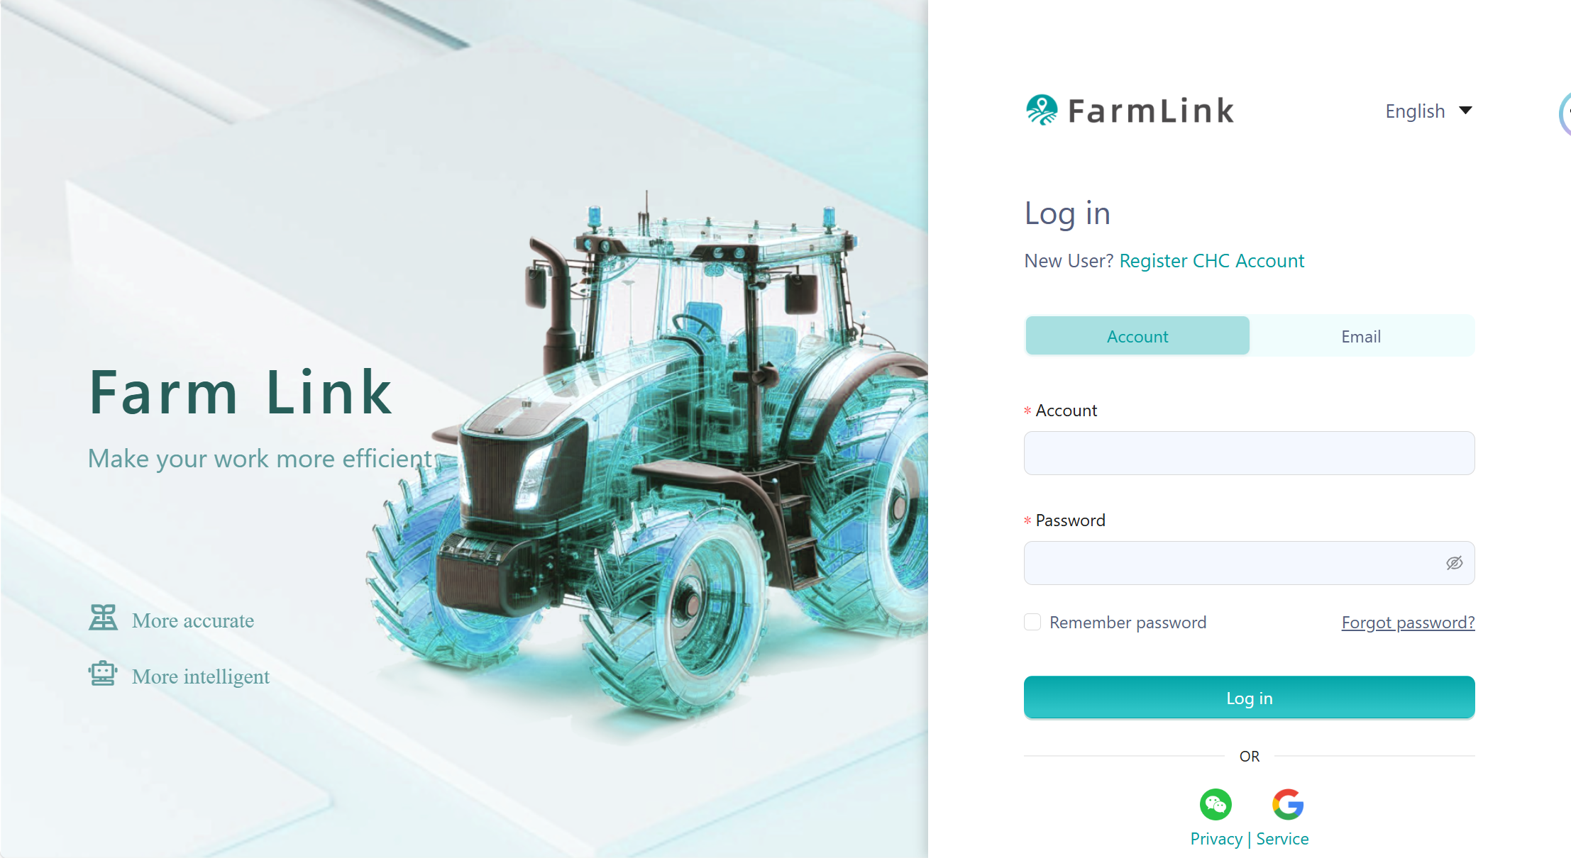
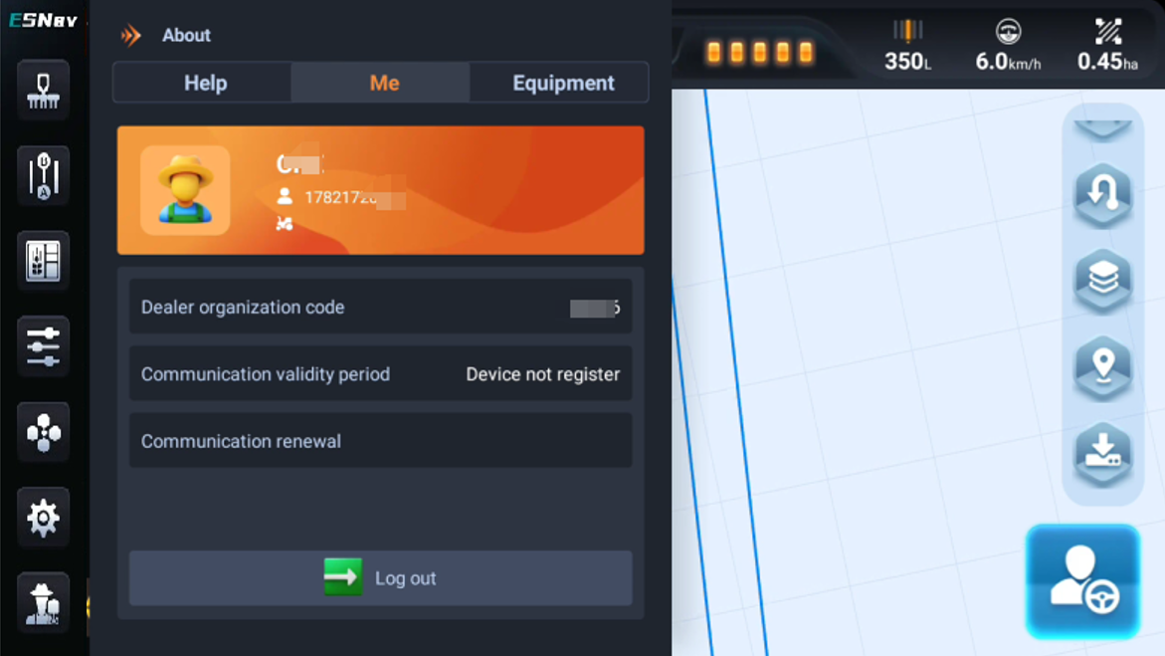
NEW FEATURES
CLOUD SERVICES
Register & Login in ESNAV5.0
1. Login in PC webpage
2. Check the real-time tractor lcoation
3. Create a new field
4. Send it to the terminal

Slide 27
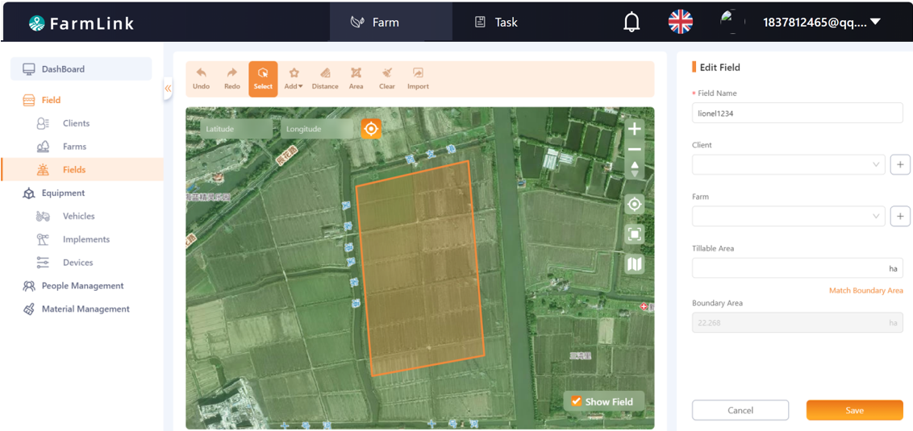
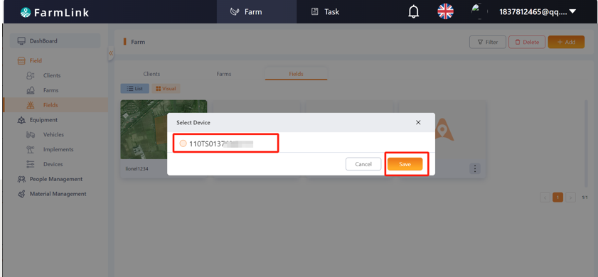
NEW FEATURES
CLOUD SERVICES
Register & Login in ESNAV5.0
1. Login in PC webpage
2. Check the real-time tractor lcoation
3. Create a new field
4. Send it to the terminal

Slide 28
NEW FEATURES
DATA TRANSFER
DATA TRANSFER

Slide 29
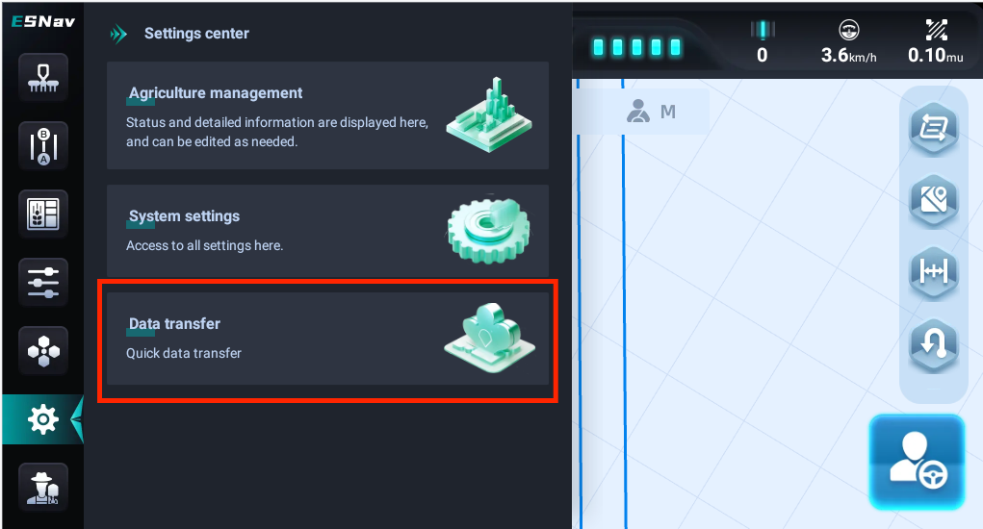
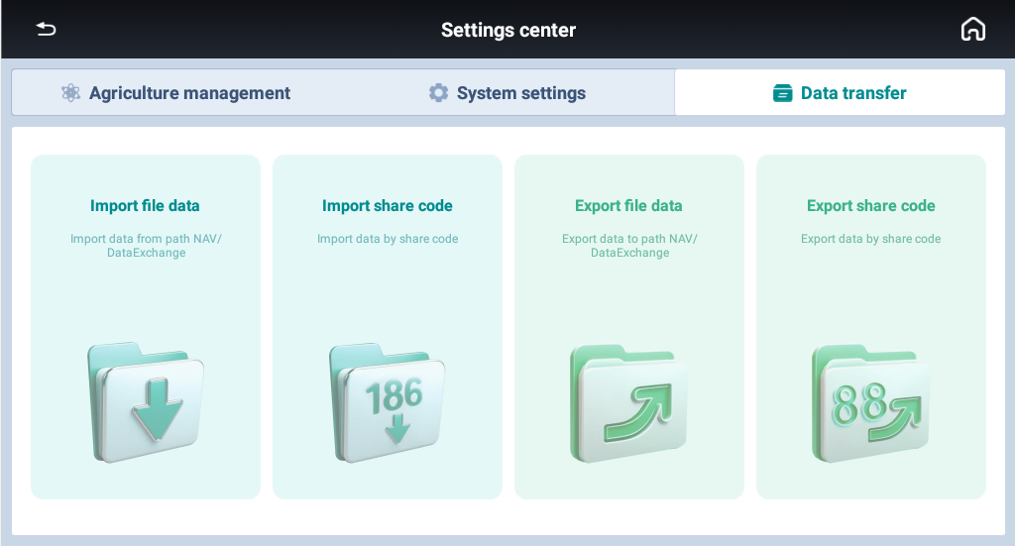
NEW FEATURES
DATA TRANSFER
Import file data
Import by share code
Export file data Export by share code

Slide 30
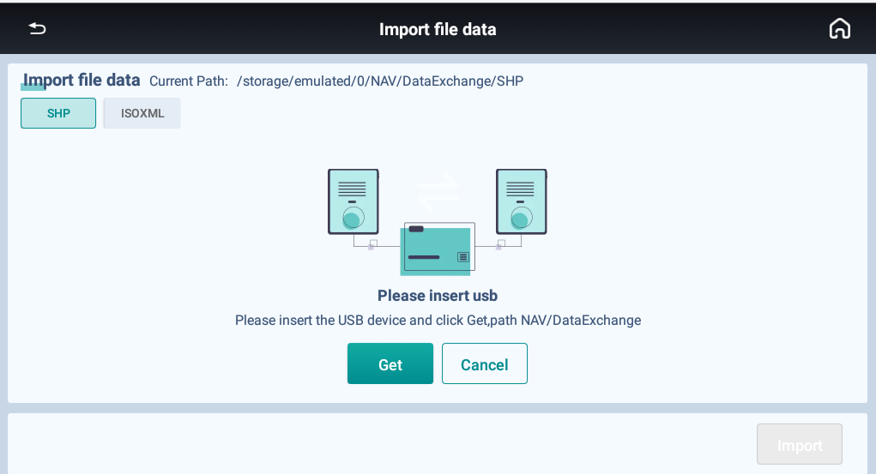
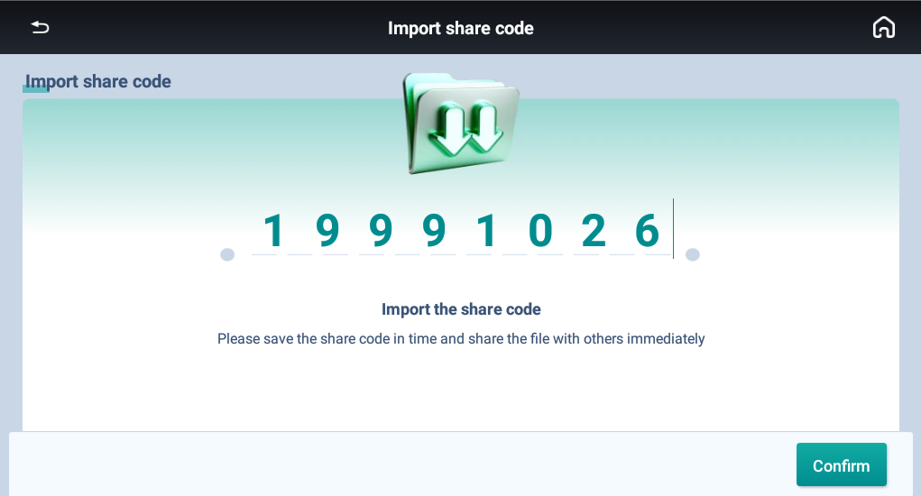
NEW FEATURES
DATA TRANSFER
When import/export file, currently SHP and ISOXML file are supported.

Slide 31
NEW FEATURES
AUTO U-TURN
AUTO U-TURN

Slide 32
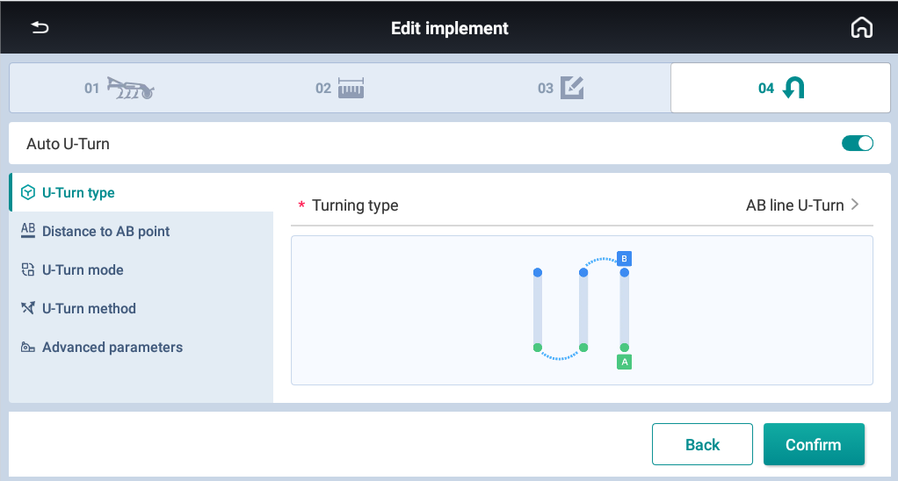
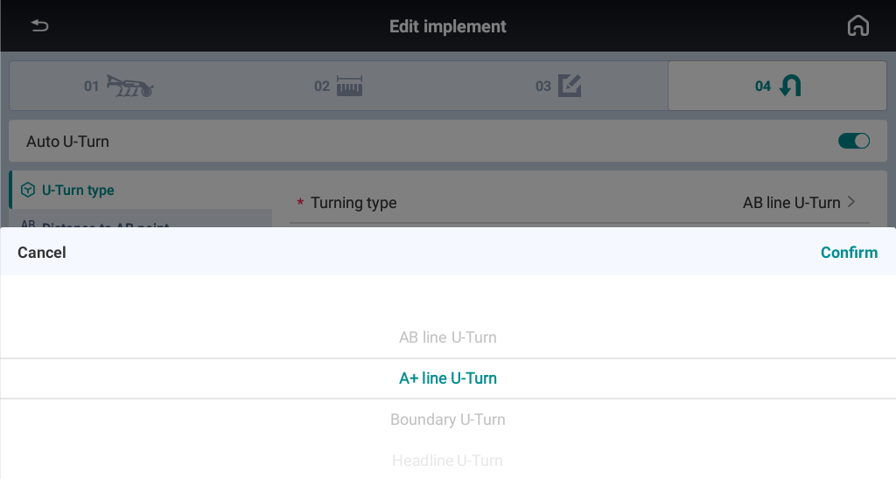
NEW FEATURES
AUTO U-TURN
Automatic U-turn switch: The option to enable/disable Auto U-turn
U-Turn type:
AB line U-turn
A+ line U-turn
Boundary U-turn
Headline U-turn

Slide 33
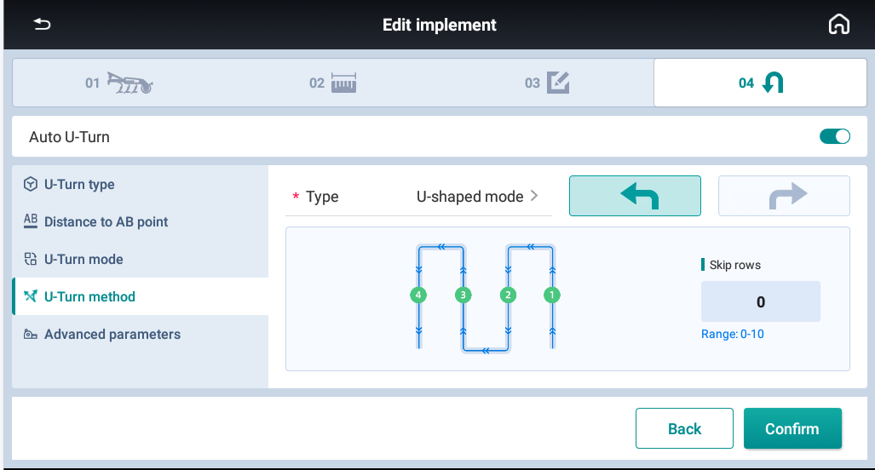
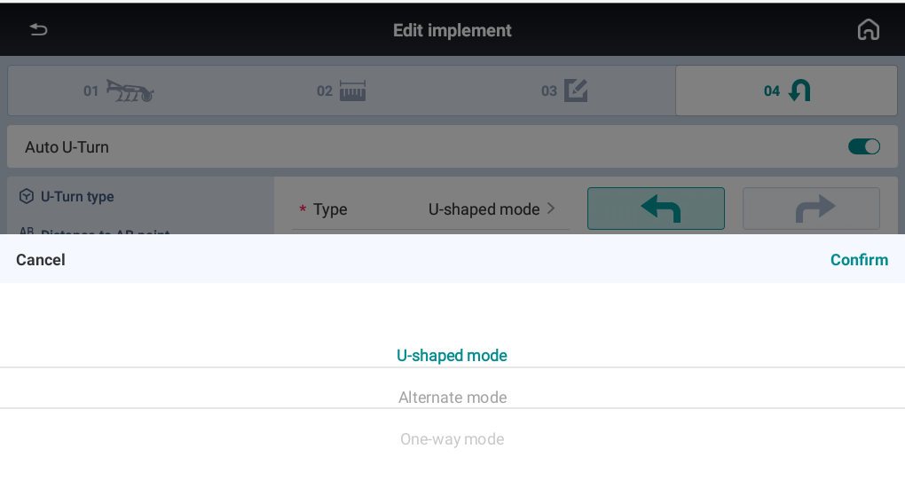
NEW FEATURES
AUTO U-TURN
AB U-TURN
1. U-shaped mode
2. Alternate mode
3. One-way mode

Slide 34
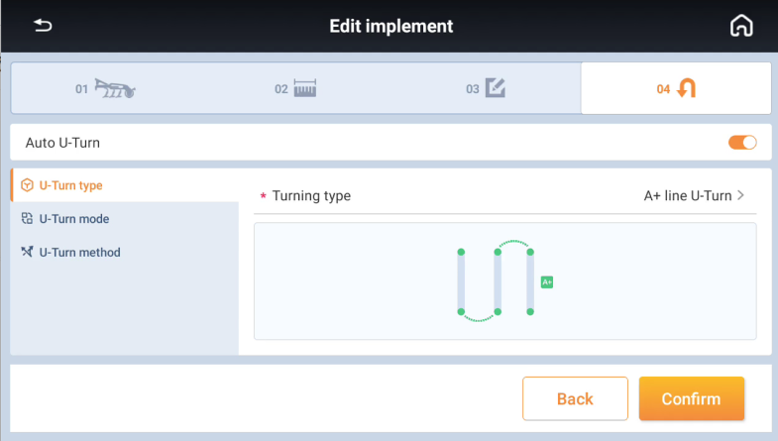
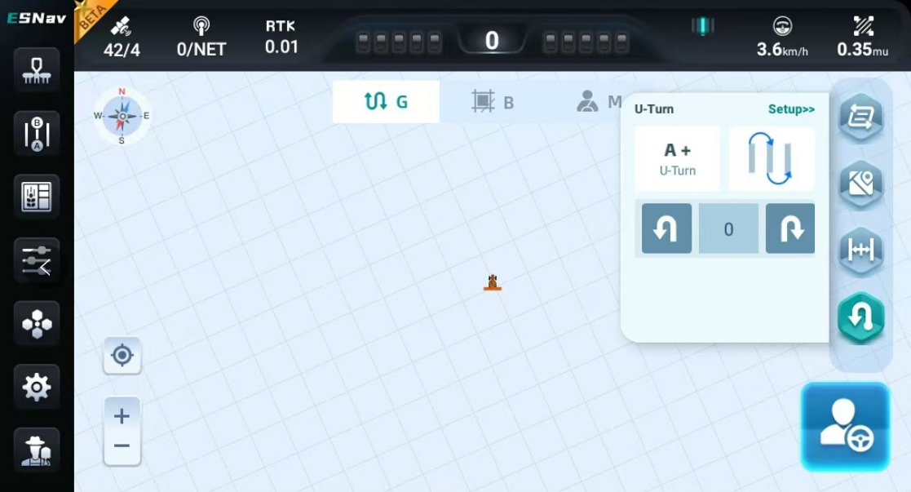
NEW FEATURES
AUTO U-TURN
A+ U-TURN
1. U-shaped mode
2. Alternate mode
3. One-way mode
4. Able to set U-Turn direction and rows manually

Slide 35
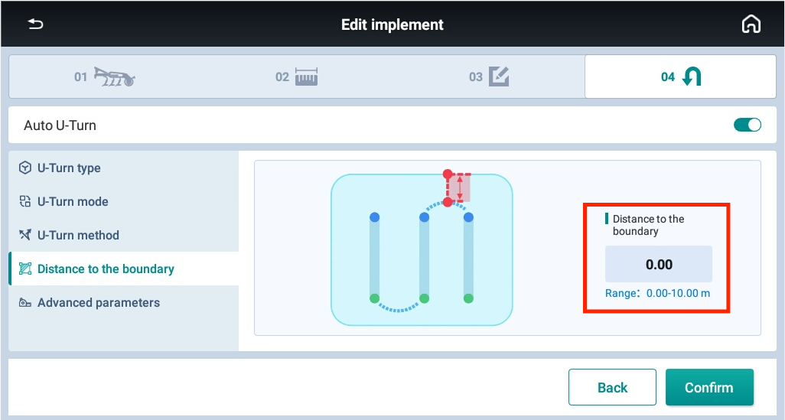
NEW FEATURES
AUTO U-TURN
BOUNDARY U-TURN
1. U-shaped mode
2. Alternate mode
3. One-way mode
4. Set the distance to the boundary

Slide 36
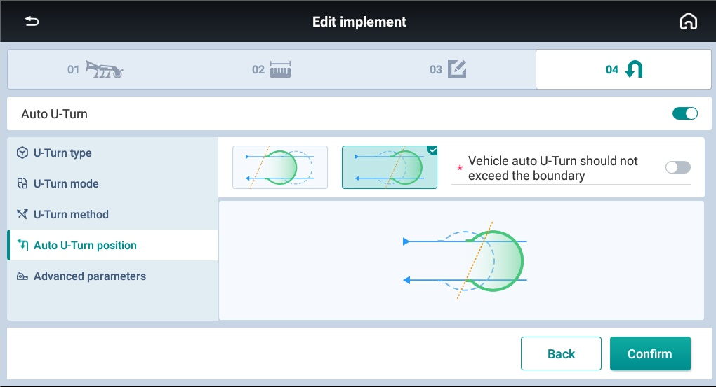
NEW FEATURES
AUTO U-TURN
HEADLINE U-TURN
1. U-shaped mode
2. Alternate mode
3. One-way mode
4. Whether exceeds the boundary

Slide 37
NEW FEATURES
SAFETY
SAFETY

Slide 38
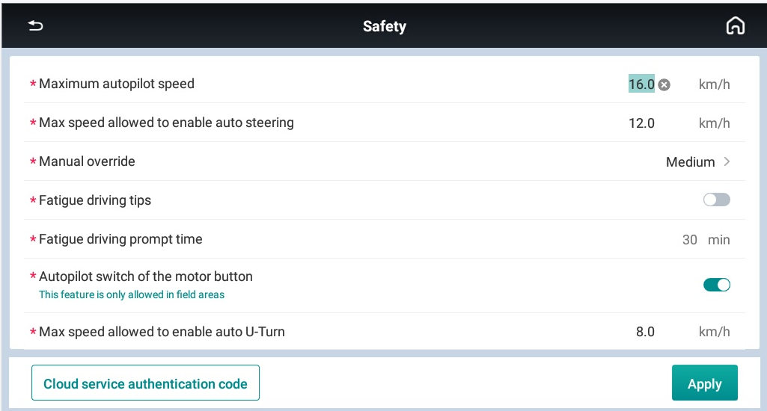
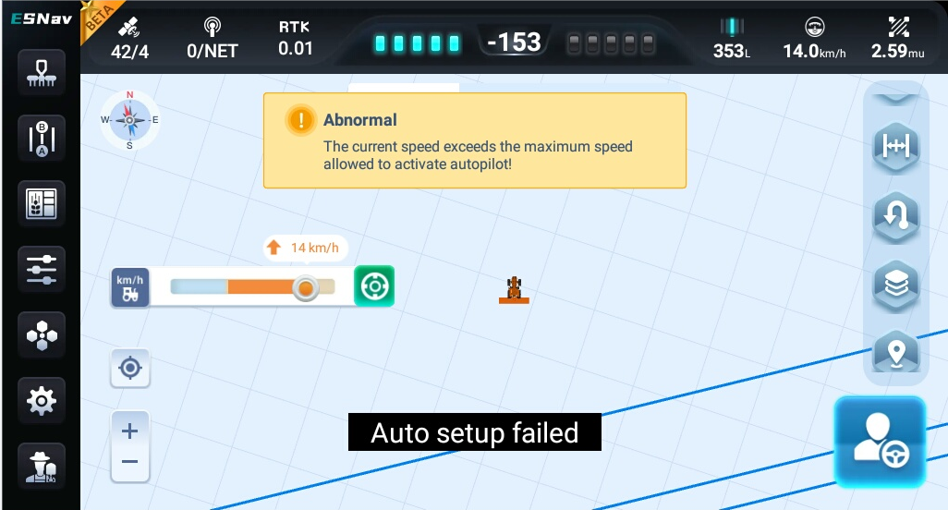
NEW FEATURES
SAFETY
Maximum speed allowed to enable Auto U-Turn
When the vehicle speed is more than the threshold, the Auto U-Turn will not be able to triggered.

Slide 39
NEW FEATURES
BOUNDARY CREATION
BOUNDARY CREATION

Slide 40
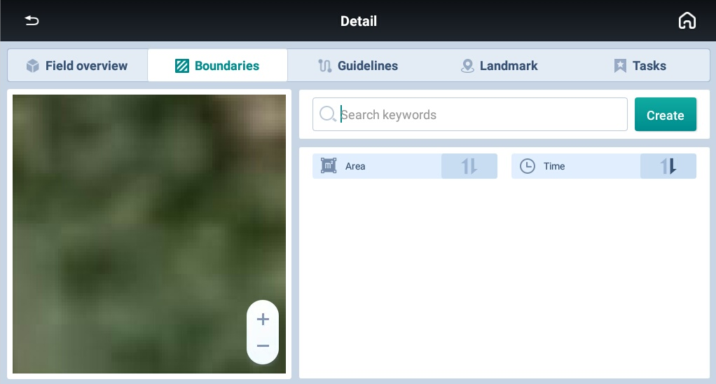
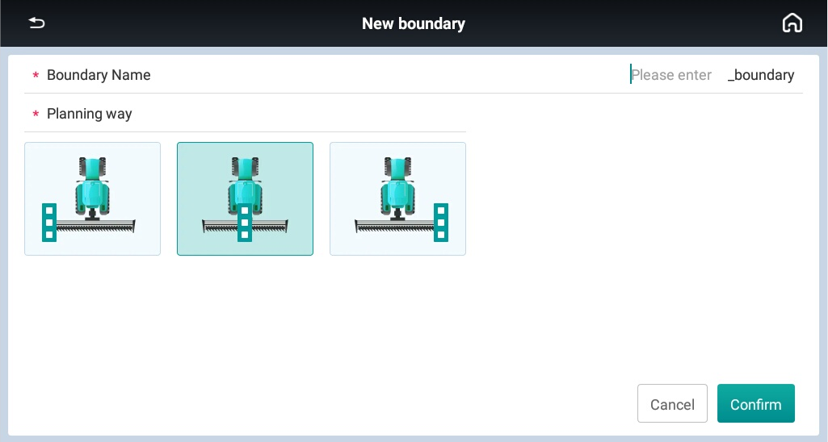
NEW FEATURES
BOUNDARY CREATION
Create a new boundary with different implement location

Slide 41
NEW FEATURES
BOUNDARY CREATION
1. Able to plan straight line and curve line
2. Able to add mark point on the boundary

Slide 42
NEW FEATURES
BOUNDARY CREATION
1. Set the headline with maximum 10
2. Snap points to create AB lines on the boundary

Slide 43
NEW FEATURES
ACCESS PATHS
ACCESS PATHS

Slide 44
NEW FEATURES
ACCESS PATHS
Drainage ditch scenarios each three rows

Slide 45
NEW FEATURES
ACCESS PATHS
1. How many lines per access path
2. Access path width
3. Rows in the first group
4. Line place in first group

Slide 46
NEW FEATURES
ACCESS PATHS
1. How many lines per access path
2. Access path width
3. Rows in the first group
4. Line place in first group

Slide 47
NEW FEATURES
TRAMLINE
TRAMLINE

Slide 48
NEW FEATURES
TRAMLINE
The principles of tramlines, they are placed in the field at seeding time. The width of the sprayboom has to be evenly divisible by the drill/air-seeder width, for example a 30' air-seeder and a 60'spray boom or a 40'air-seeder and a 120'spray boom.

Slide 49
NEW FEATURES
TRAMLINE
1. Swath spacing
2. Offset
3. Initial swath

Slide 50
NEW FEATURES
TRAMLINE
1. Set the original line in the main interface Line Offset Settings;
2.The Tramline will be highlighted.

Slide 51
NEW FEATURES
ISOBUS UT & TC-SC
ISOBUS UT & TC-SC

Slide 52
NEW FEATURES
ISOBUS UT & TC-SC
ISOBUS enable/disable

Slide 53
NEW FEATURES
ISOBUS UT & TC-SC
Manual section control

Slide 54
NEW FEATURES
ISOBUS UT & TC-SC
Auto section control

Slide 55
NEW FEATURES
LANDMARK
LANDMARK

Slide 56
NEW FEATURES
LANDMARK
View and manage landmark.
1. Different markers can be configured in the Landmark Library;
2. Setting the marker reference in Recording Position.

Slide 57
NEW FEATURES
LANDMARK
It is avaliable to set markers in the mainterface by shortcut icon

Slide 58
NEW FEATURES
TRAJECTORY RECORDING
TRAJECTORY RECORDING

Slide 59
NEW FEATURES
TRAJECTORY RECORDING
Record real-time track 3D coordinates, which can be exported in txt and shp formats.
In Brazil, many customers want to record the real track when do auto steering because some ground may be not flat and the vehicle will slide, so it is necessary to record the real one and use the same one next time.

Slide 60
NEW FEATURES
TRAJECTORY RECORDING
After recording the data, it is able to export data by SHP/ISOXML format.

Slide 61
NEW FEATURES
IMPLEMENT SIGNAL INPUT
IMPLEMENT SIGNAL INPUT

Slide 62
NEW FEATURES
IMPLEMENT SIGNAL INPUT
It is allowed to turn on input detection to enable/disable autopilot or track painting by implement different voltage signals.

Slide 63
NEW FEATURES
TRACK PAINTING COLOR
TRACK PAINTING COLOR

Slide 64
NEW FEATURES
TRACK PAINTING COLOR
Track painting color can support 6 colors right now.

Slide 65
NEW FEATURES
3D VIEW & BRIGNTNESS
3D VIEW & BRIGNTNESS

Slide 66
NEW FEATURES
3D VIEW & BRIGNTNESS
2D/3D view and Day/Night mode are supported.

Slide 67
NEW FEATURES
MATERIALS
MATERIALS

Slide 68
NEW FEATURES
MATERIALS
Manage spraying equipment and materials on this interface.

Slide 69
NEW FEATURES
TROUBLESHOOTING
TROUBLESHOOTING

Slide 70
NEW FEATURES
TROUBLESHOOTING
When encountering a malfunction, please check the information of each module on this interface and provide it to EFIX engineers.

Slide 71
NEW FEATURES
BOOT GUIDE
BOOT GUIDE

Slide 72
NEW FEATURES
BOOT GUIDE
It is necessary to enter the corresponding dealer code andlanguage to enter the software.

Slide 73
NEW FEATURES
HANDLE
HANDLE/MULTI-FUNCTION BUTTON

Slide 74
NEW FEATURES
HANDLE
1. Able to check status & version number
2. Able to customize the feature

Slide 75
NEW FEATURES
PRIVACY SECURITY
PRIVACY SECURITY

Slide 76
NEW FEATURES
PRIVACY SECURITY
Muliple items with password protection

Slide 77
NEW FEATURES
ONE-CLICK UPDATE
ONE-CLICK UPDATE

Slide 78
NEW FEATURES
ONE-CLICK UPDATE
After connecting to the Internet, the software will automatically detect updateable software or firmware, automatically download the latest version and update it.

Slide 79
NEW FEATURES
PARAMETERS ADJUSTMENT
PARAMETERS ADJUSTMENT

Slide 80
NEW FEATURES
PARAMETERS ADJUSTMENT
Adjust Online Aggressiveness, WAS GAIN and other parameters

Slide 81
NEW FEATURES
NEW GUIDELINE MODES
NEW GUIDELINE MODES

Slide 82
NEW FEATURES
NEW GUIDELINE MODES
1. Looped guideline
2. Whole area path line

Slide 83
NEW FEATURES
NEW GUIDELINE MODES
NEW GUIDELINE MODES---WHOLE AREA PATH LINE
1. Need 4 points
2. All are with Auto modes

Slide 84
NEW FEATURES
NEW GUIDELINE MODES
NEW GUIDELINE MODES---LOOPED LINE
1. Need 4 points
2. All are with Auto modes

Slide 85
Yield more with less
Thank You

